Slide 1
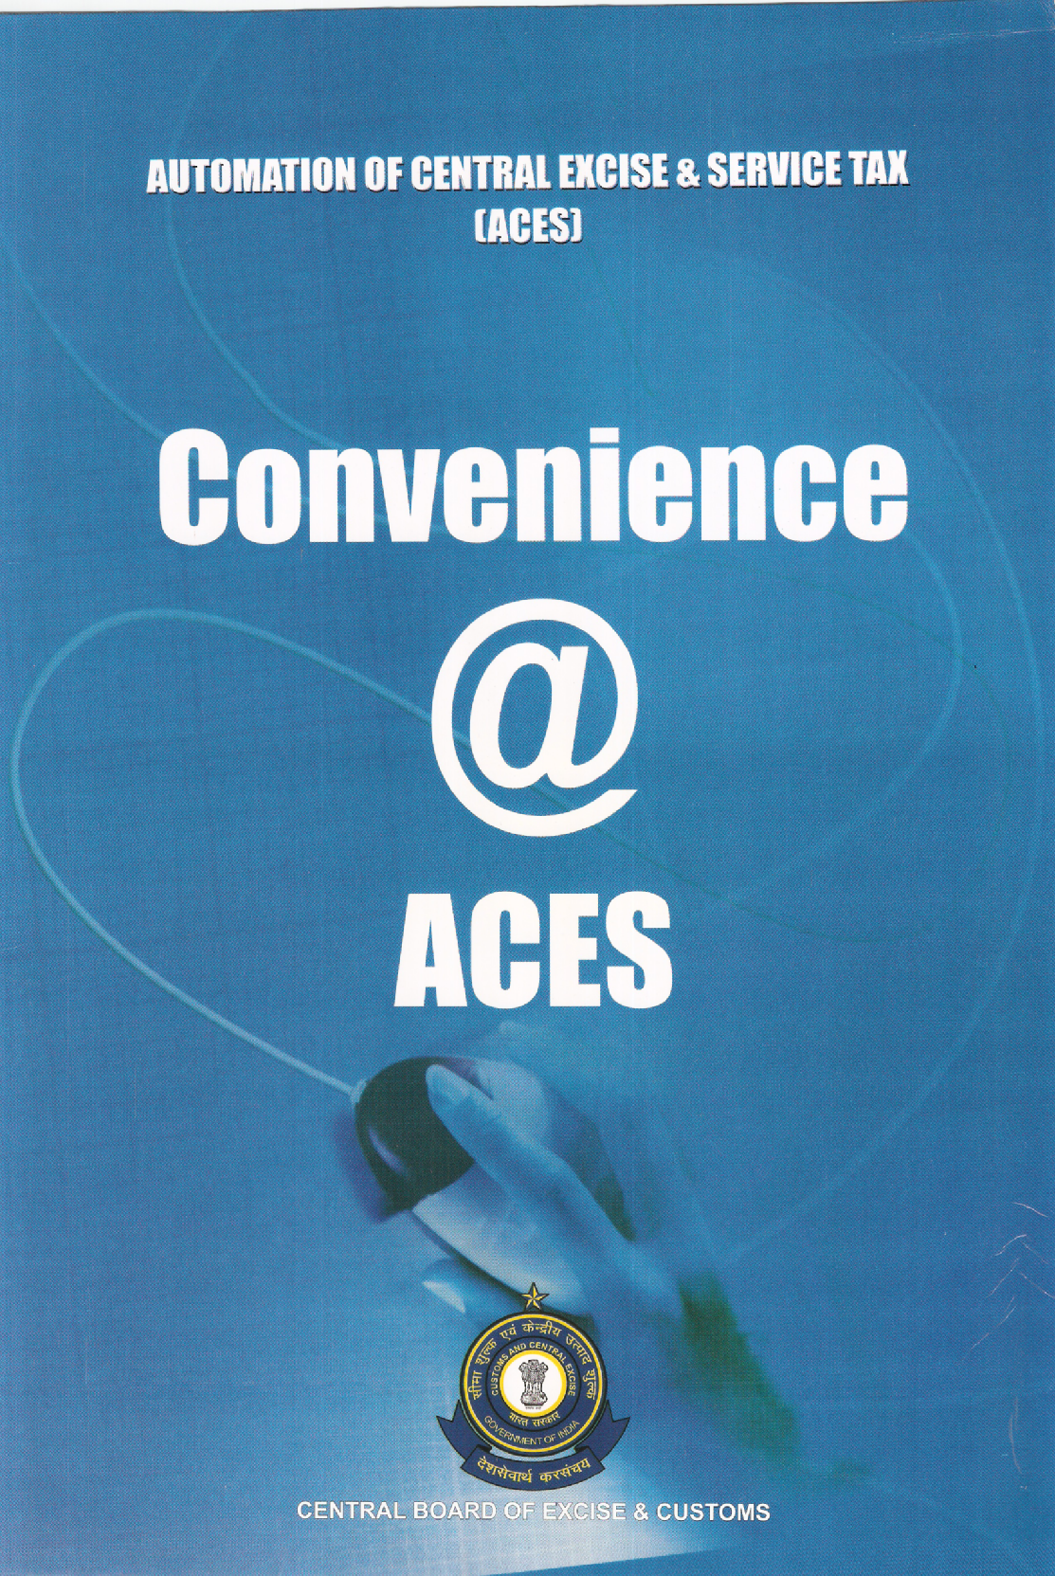

Slide 2

ACES - Highlights
ACES is a Mission Mode Project of Govt. of India under National e-Governance Plan
Centralized,Web-based,Workflow-based System
Provides complete End-to-End Solution
Major Processes in Central Excise & Service Tax covered
ACES website attracted hits over 31 crores
More than 5 lakh Central Excise Returns filed online in ACES
Capable to accept Digitally-signed Documents

Slide 3
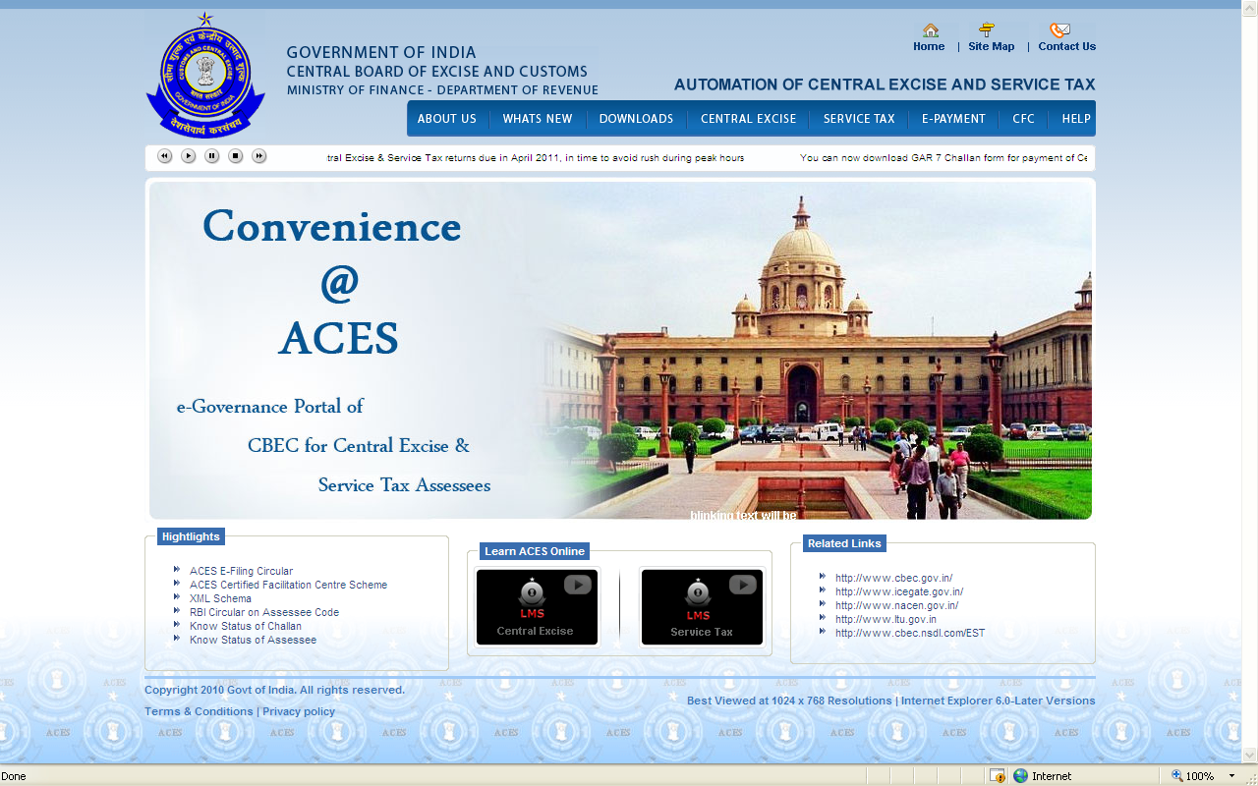
ACES – Home Page

Slide 4
ACES – Modules
Available in Menu Bar on top of the Screen
Central Excise Service Tax
REG – Registration REG - Registration
RET – Returns RET - Returns
PRA - Provisional Assessment ST 3 A
REF – Refunds REF - Refunds
DSR - Dispute Resolution DSR
AUD – Audit AUD – Audit
CLI - Claims and Intimations
EXP – Exports

Slide 5
INTERFACE
  INCOME TAX – Online Verification of PAN
  EASIEST – Verification of Payment Particulars (GAR 7 Challans) from Banks through CBEC’s EASIEST Portal being maintained by NSDL

Slide 6
ACES – Benefits to Assessees
Reduce Physical Interface with Department
Online Registration of Central Excise Assessees and online amendment
Online Registration of Service Tax Assesses and online amendment
Electronic filing of Central Excise Returns
Electronic filing of Service Tax Returns
Electronic filing of Claims, Permissions, Intimations
Instant E-acknowledgement of documents with Unique Document Identification Number
View, File and Track Status of Documents filed online

Slide 7
ACES – Benefits to Assessees
Revenue Reconciliation (Payment information from Banks are reconciled with the information mentioned in the returns submitted by the assessees)
Online Messages/ Alerts on business related matters
Online filing of reply to Show Cause Notice
Online filing of application for Provisional Assessment
Online filing of Refund Claims
Online filing of selected Export related documents
Online filing of Appeals to Commissioner (Appeals)
All Services Available Free of Cost

Slide 8
ACES-New Developments- CBEC Notification
CBEC has issued Notification No. 04/2010-Central Excise (N.T.) and Notification No. 01/2010-Service Tax, both dated 19th Feb, 2010, making e-filing of Central Excise Returns (ER-1 and ER-3) and Service Tax Return (ST-3) mandatory for assessees with effect from 1st April, 2010
The facility of e-filing of returns on the website (http://exciseandservicetax.nic.in), as provided in the CBEC Circular No.791/24/2004-CX dated 1.6.2004, has been withdrawn and the assessees are required to file their returns online or by uploading the downloadable off-line return utilities to the new ACES website (http://www.aces.gov.in)

Slide 9
ACES-New Developments- CBEC Circular
CBEC has issued Notification No 20-21/2010 CE (NT) dtd. 18.05.2010 and CBEC Circular No. 926/16/2010 – CX, dtd. 28th May 2010
By this E-filing of ER 2, ER 4, ER 5 , ER 6 returns has been made mandatory for assesses, who have paid Central Excise duty of Rs. 10 lakh or more( including payment by utilistaion of Cenvat credit) in the previous financial year
Similarly all Dealers have to e-file Returns mandatorily wef 1st June, 2010
CBEC has issued a Circular No. 919/09/2010-CX dated 23rd March 2010 on the procedure for Electronic filing of Central Excise and Service Tax Returns and for Electronic Payment of Excise Duty and Service Tax
Refer to ‘What’s New’ Section of ACES website for details

Slide 10
ACES-New Developments- RBI Circular
R.B.I issued Circular DGBA.GAD.No.H - 850/41.07.003/ 2010-11 dated 29th July 2010
It makes it mandatory for the authorised banks to accept Central Excise and Service Tax payments from only those assessees whose Assessee Codes (Registration Numbers) exist in the EASIEST Directory, with effect from 1st September, 2010
The assessees can themselves verify the existence of their Assessee Codes in the NSDL website www.cbec.nsdl.com
If it does not exist, they can approach the jurisdictional officer
In case the registration number has not been generated by the system (erstwhile SACER /SAPS or the current ACES application), assesses have to apply afresh for a new Registration Certificate through ACES as a new assessee
Assessees code is transferred to Assessee Code Directory only after the registration certificate is issued by the jurisdictional Officer.

Slide 11
ACES-New Developments- CFCs
ACES Certified Facilitation Centres (CFCs) have been set up by the eligible Members of:
  Institute of Chartered Accountants of India (ICAI)
  Institute of Cost and Works Accountants of India (ICWAI)
  Institute of Company Secretaries of India (ICSI)
CFCs provides services to taxpayers who may not have requisite IT infrastructure / resources, to use ACES
This is on payment of prescribed fees
The details such as MOUs, CFC Scheme, User Manuals, FAQs are available under the CFC link in ACES website (www.aces.gov.in)

Slide 12
ACES-New Developments- XSD Schema
A new feature of XML Schema is introduced by which assessees can create XML based on the predefined XSD schema
Assesses who use their own software application can generate their Central Excise returns by using data available in their own database, after making necessary modifications in their software applications.
If any user has huge data to upload, instead of entering data manually, it can use its own application for generating XML using the XSD Schema, made available.

Slide 13
REGISTRATION
Two Types of Registrations:
    Registration with ACES and
    Registration with the Department as Assessee
Registration with ACES is different from Registration with Department
On-line Registration for assessee is available for:
    Existing Assessee
    New Assessee
    LTU Assessee
    Non-Assessee
New Registration Structure
    10 – PAN
    11-12 - EM/ED/SD
    13-15 - Alpha-Numeric

Slide 14
Existing Assesses – Initial Process
Data of Existing Assessees have beenmigrated to ACES
No need to obtain fresh registrations
For all the Existing Assesses, the system has generated TPINs (Temporary Personal Identification Number) and Passwords. The format of TPIN is t + 9 digit number e.g. t012345678
Existing Assessees, whose email IDs are available in CBEC’s database, would receive TPIN mails from department.
The Assessee has to click the hyperlink in the email and provide the information for creating user profile in ACES
Using User Name and Password, assessee can login to ACES

Slide 15
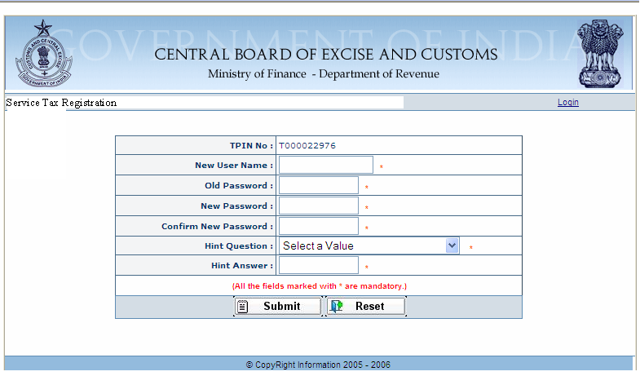
Existing Assesses – Initial Log on process…..Contd
To received e-mail
6-12 digit alphanumeric, first digit should be a character, only “_” allowed as special character. Once chosen User ID cannot be changed
Assessee can choose 6 digit password

Slide 16
Action for the non receipt of email
The assessee may not receive TPIN Mails in following situations:
  e-Mail ID is not available in ACES database
  e-Mail ID is incorrect in ACES data base
Procedure for obtaining TPIN mail
  The assessee intimates non receipt of email and furnishes the correct email ID to the concerned Jurisdictional Officer
  Jurisdictional Officer corrects the email id of assessee and regenerates the Password by sending a mail
  TPIN and newly generated Password is mailed automatically to the new email ID given by the assessee

Slide 17
Registration Procedure for New Assessee (Registrant)
User to access ACES application by clicking http:/www.aces.gov.in
User to click Central Excise Or Service Tax as required
Select the hyperlink “New Users to Click Here to Register with ACES” to go for Creation of User Name.
This Screen enables creation of User Name(ID) & Password (given by the User) after entry of valid E-mail ID and other basic details of the person registering with the ACES Application.
User ID once selected is Permanent, Password should be changed regularly
Assessee receives an e-acknowledgement

Slide 18
ACES Home Page
http://www.aces.gov.in
Login for C.Ex. Assessee
Login for Service Tax Assessee

Slide 19
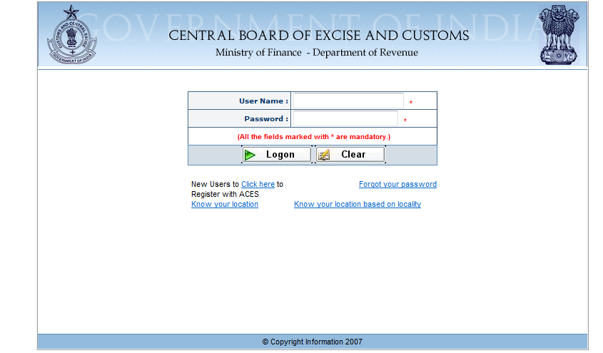
New User -Registration with ACES
New Assessee
to Click here

Slide 20
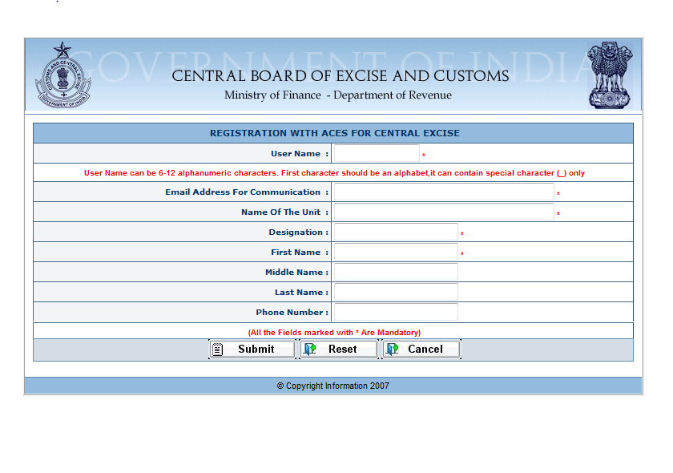
New User -Registration ….Contd
Alphanumeric Name selected by the User
Email ID of the User for future correspondence from ACES

Slide 21
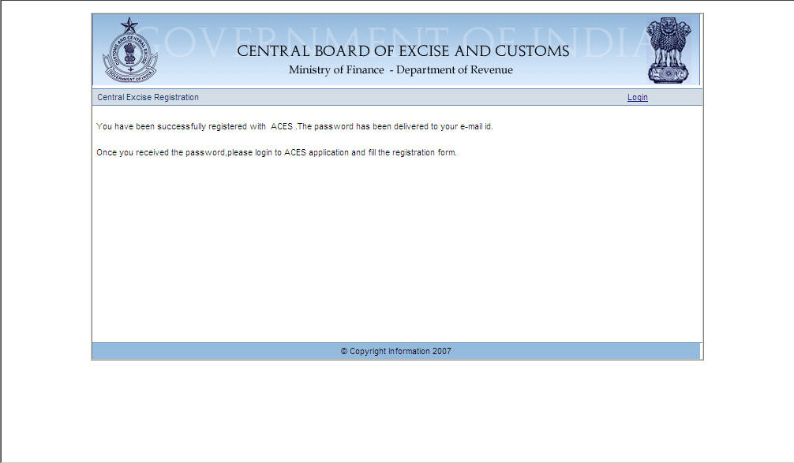
New User - Registration with ACES
e- Acknowledgement

Slide 22
New Service Tax Registration
Once registered with ACES Application, the assessee goes to ACES website and clicks on Service Tax link and fills in the user name & password to log in to the Application
Select REG Module -> Option Fill Form
Fill Form ST-1
This will enable Online filing of Application Form for Registration with Department

Slide 23
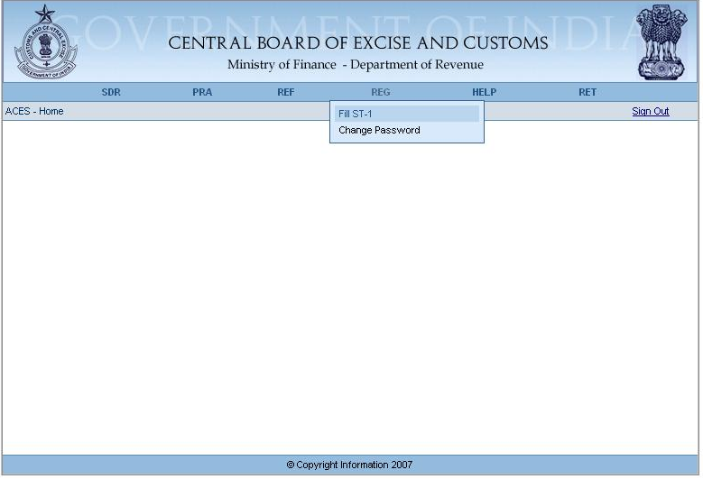
New Service Tax Registration

Slide 24
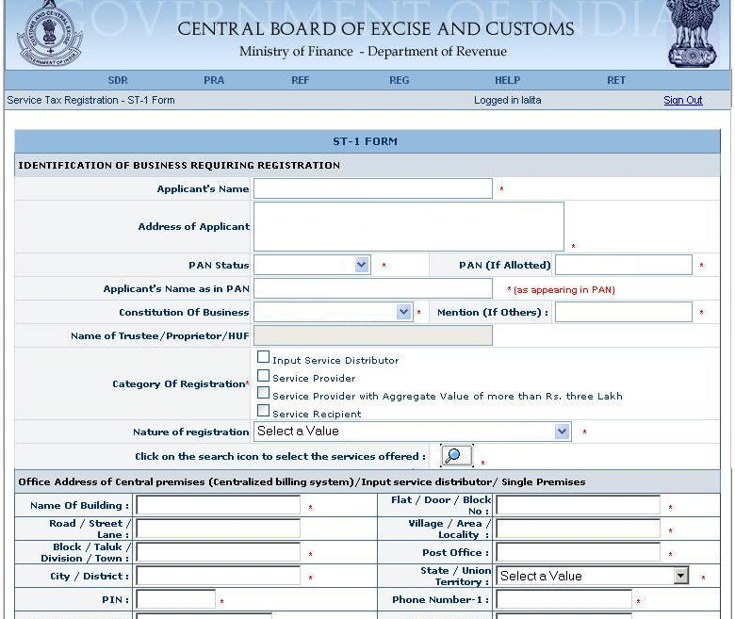
New Service Tax Registration..Fill ST-1

Slide 25
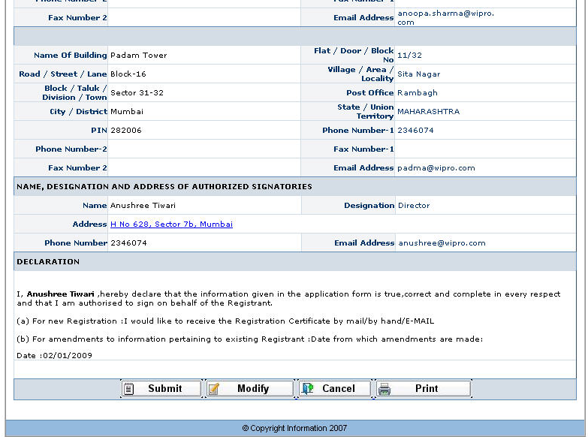
New Service Tax Registration..Fill ST-1…..Contd

Slide 26
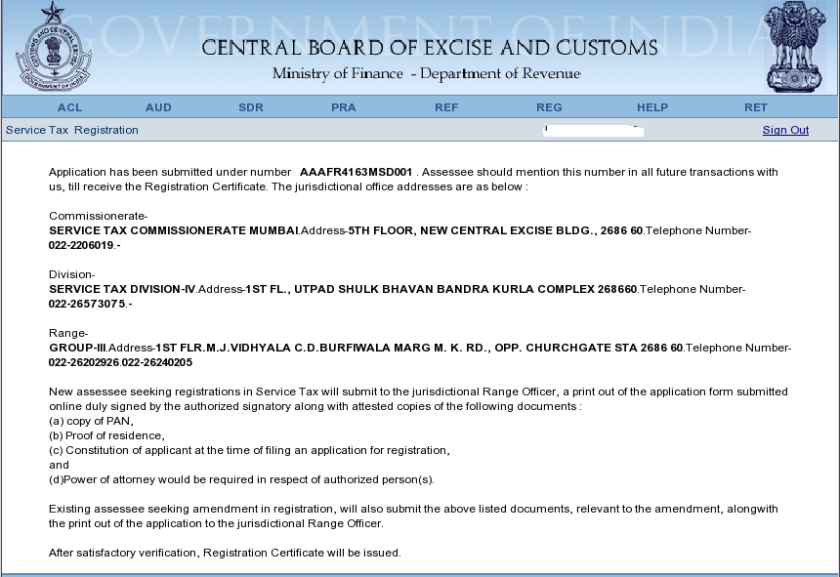
ST-1 – E-Acknowledgement

Slide 27
Registration of Non-Assessee
Applicable to Persons such as :
Merchant Exporters
Persons other than Registered Assessees who wish to file refund claims
Co-Noticees in Departmental proceedings
Persons who have failed to obtain CE/ST registration and against whom the Department has initiated proceedings
Persons who are required to tender any payment to the Dept

Slide 28
Registration of Non-Assessee – Contd.
Mandatory to have Assessee Code for making payments through banks
Non-Assessee Codes are passed on to banks through NSDL for enabling them to make payment
Non-Assessee Code not a statutory registration but required to recognise as an User of ACES
Code can be generated by the Non-Assessee or by Departmental Officer by filling-in a Form
Code can be PAN or Non-PAN based but for claiming refunds from department, PAN is mandatory

Slide 29
E-filing of Returns
On-line Filing of Self-Assessed Returns
Off-line Downloadable Utilities Available at ACES website
ACES validates Registration No, Period of Return, CETSH, Notification, Rates of Duty
Status of Returns – Uploaded, Filed or Rejected
Returns verified with GAR 7 Challan Details obtained through EASIEST
CE Returns with errors marked for Review and Correction by Superintendent.
Message regarding modification sent to assessee, who can view the reviewed return

Slide 30
CE - Claims, Intimations and Permissions
Permission for multiple invoices, intimation usage, cancellation & authorized issuer of invoices
Application for Remission of Duty
Application for permission to pay duty and remove final products from job workers premises
Application for availing the benefit of SSI exemption
Application for Transfer of CENVAT Credit
Application for Permission to remove semi-finished goods for certain purposes
Record Maintenance
Account of Removal
Application of Procurement of Excisable Goods at Concessional Rate of Duty
Intimation for monthly return for removal of Goods at Concessional rate of duty
Intimation regarding receipt of imported goods at Concessional rate of duty
Application for permission to remove excisable goods for carrying out tests

Slide 31
Provisional Assessment
Facility to file Provisional Assessment requests online by Assesses.
Order for Provisional Assessment issued online by Department
Facility to file Provisional Assessment extension requests online by Assesses
Provisional Assessment finalization order issued online
Details of B 1 bond captured in ACES

Slide 32
Dispute Resolution
Online issue of Show Cause Notices by Department
Facilitates Assesses to file reply to SCNs online
Intimations regarding issuance of SCNs, Date and Place of Personal Hearing and Orders are sent online
Can view Orders online
Assesses can e-file appeals to Commissioner (Appeals)

Slide 33
Refunds
Refund Claims can be filed online
Passing of Refund Orders online by Department
If aggrieved, Appeals can be filed with Commissioner (Appeals)

Slide 34
Central Excise - Exports
ACES provides online filing of documents for various categories of exporters like Merchant Exporters, Manufacturer Exporter, EOUs and Export Houses
Bond details captured online
Online filing of AREI, ARE2, Nepal invoice, CT1,CT2,CT3, Procurement Certificate etc

Slide 35
ACES – Service Desk
Toll Free Number – 1800 425 4251, Available from 9.00 AM to 7.00 PM on working days
Complaint can also be E-mailed to aces.servicedesk@icegate.gov.in
A ticket or complaint number is assigned by the Service Desk, which is closed only when the issue is resolved
Resolution of Problems communicated
Provision for escalation of problems to appropriate technical teams for effective resolution

Slide 36
ACES – Help
LMS, User Manual, FAQs are available in ACES website under ‘Help’ Section
LMS is a self-learning, multi-media-based Learning Management Software (LMS)- Available for Registrations, Returns, Claims & Intimations, Provisional Assessments, Exports
User Manuals Registrations, Claims & Intimations
Frequently Asked Questions (FAQs)- General, Registration, Return
ACES Brochure giving details of various features of ACES is available on the website

Slide 37







Essentials
Java enabled Web browsers
System with Internet Connectivity
Valid Email Id
2003 & Above
For Offline working
User ID
Password
Notes:
37

Slide 38
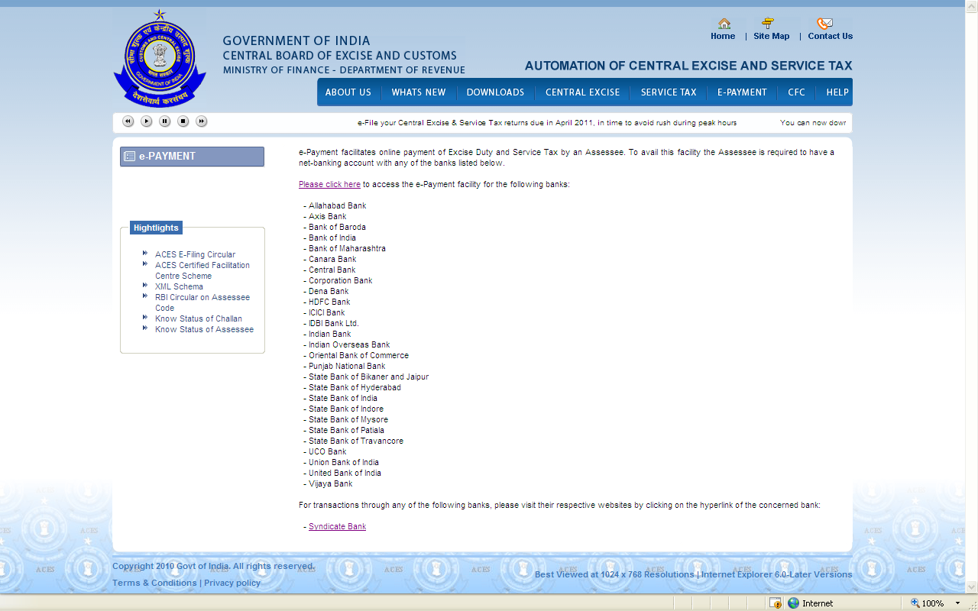
List of Banks for e-Payment

Slide 39
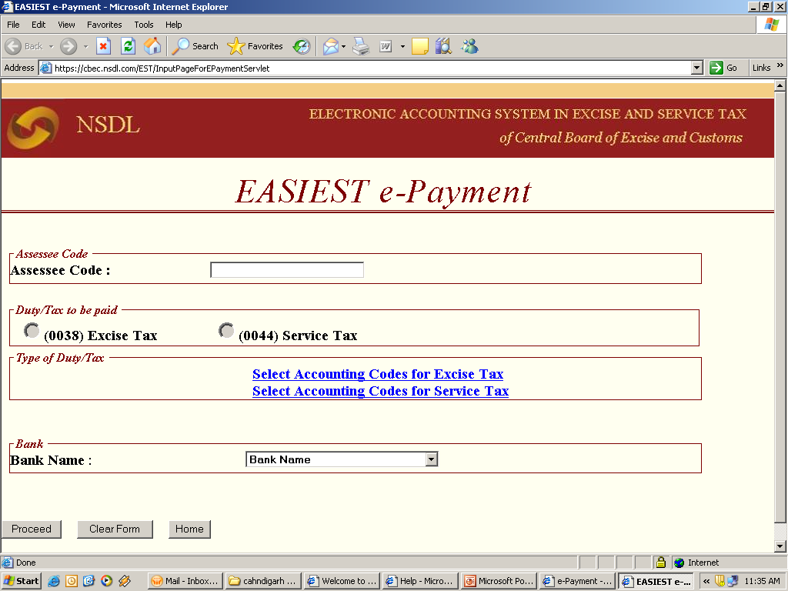

Slide 40



THANK YOU

